Slide 1
DATASOFTIXS INTERNSHIP
DATA SCIENCE
Name : Vellingta P
Intern ID : DS100004

Slide 2
Task1: Sales Data Analysis
Name : Vellingta P
Date : 4/01/2025

Slide 3
DESCRIPTION
This project analyzes a retail store's sales data to derive actionable insights.
The workflow involves loading and cleaning the data, calculating key metrics, and visualizing trends to understand sales performance over time.
CODE INSIGHTS
Data Loading and Data Cleaning
import pandas as pd
# Load the sales data
data = pd.read_csv('sales_data.csv')
# Data cleaning: Remove missing values and check data types
data.dropna(inplace=True)
data['Sales'] = data['Sales'].astype(float)

Slide 4
Calculations:
# Calculate total and average sales
total_sales = data['Sales'].sum()
average_sales = data['Sales'].mean()
# Group by date for sales trends
sales_trend = data.groupby('Date')['Sales'].sum()
Visualization:
import matplotlib.pyplot as plt
# Plot sales trends over time
plt.figure(figsize=(10, 6))
sales_trend.plot(kind='line')
plt.title('Sales Trends Over Time')
plt.xlabel('Date')
plt.ylabel('Total Sales')
plt.grid()
plt.show()

Slide 5
Tools and Technologies Used
Libraries: Pandas, Matplotlib, NumPy, Seaborn
Python
Visual Studio Code
Results
Total Sales : 2252607.41
Average Sales: 230.12
Highest sold product: Advanced Copier

Slide 6
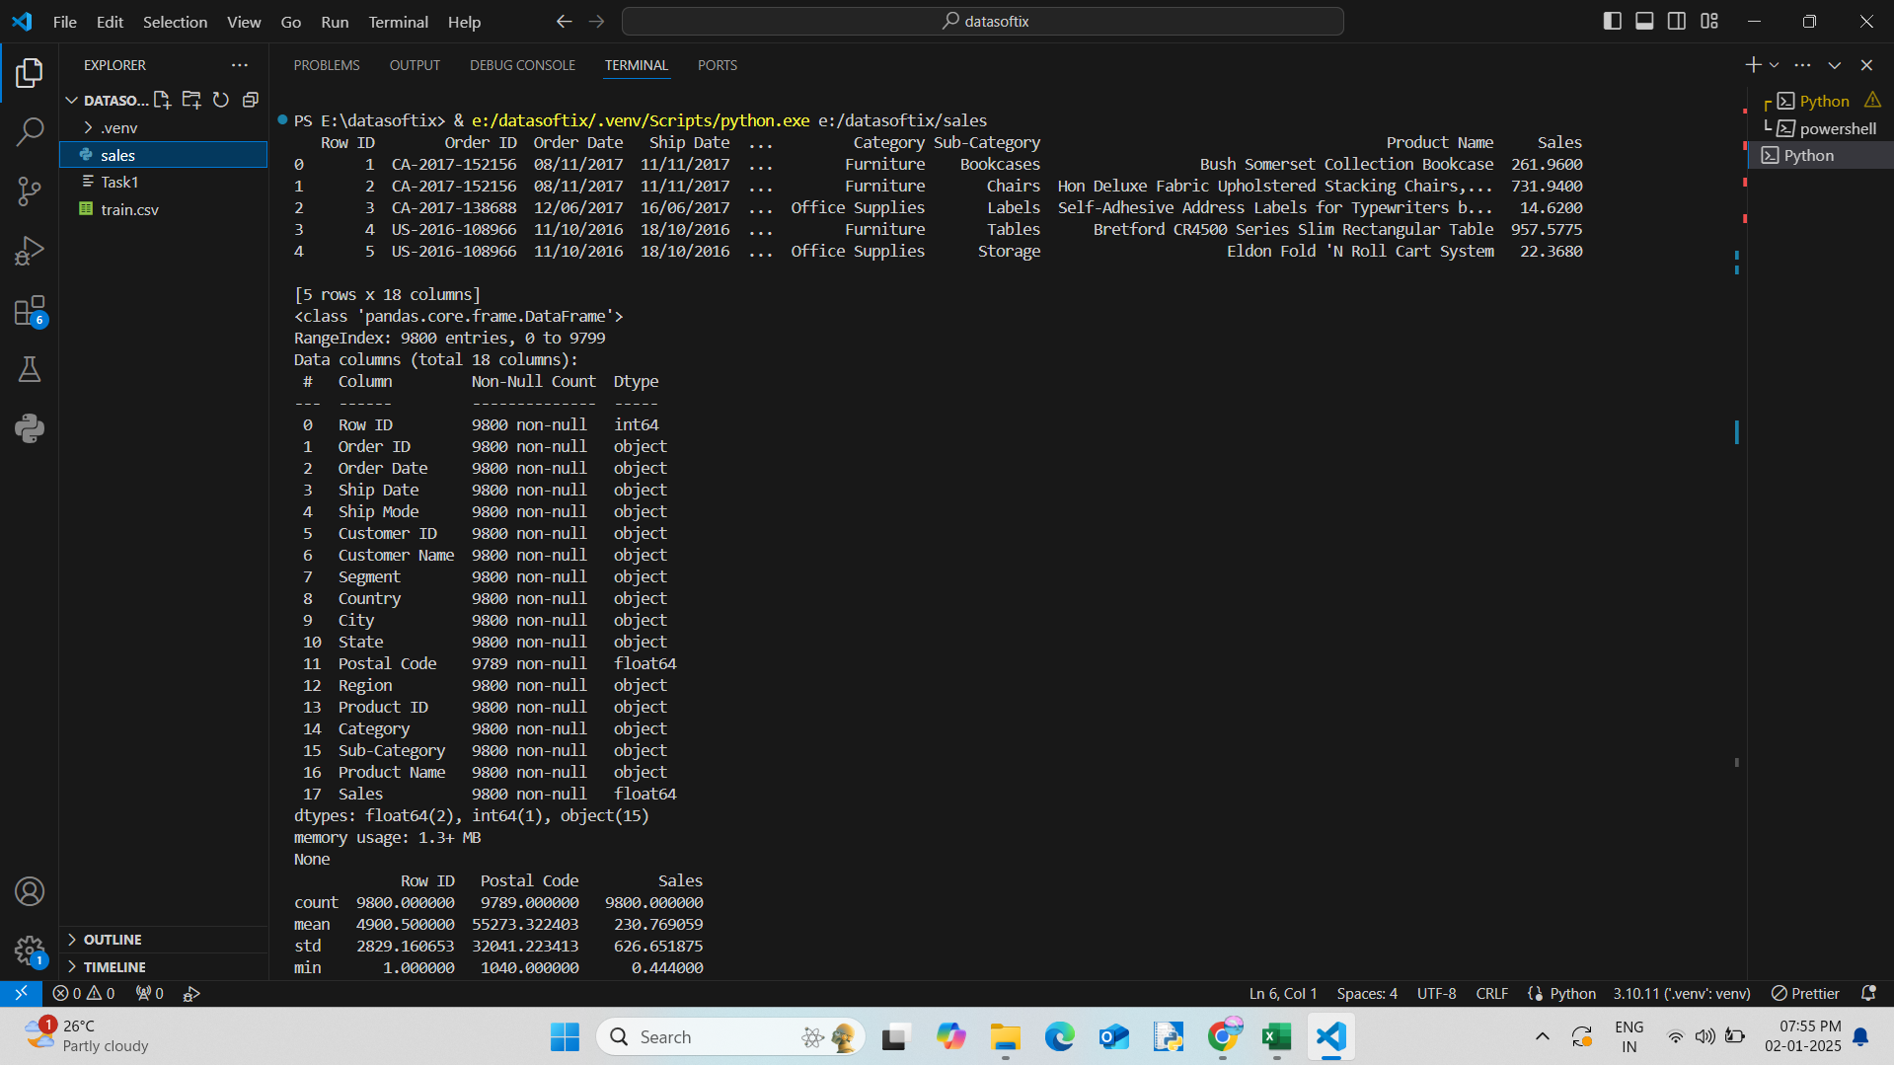
Output

Slide 7
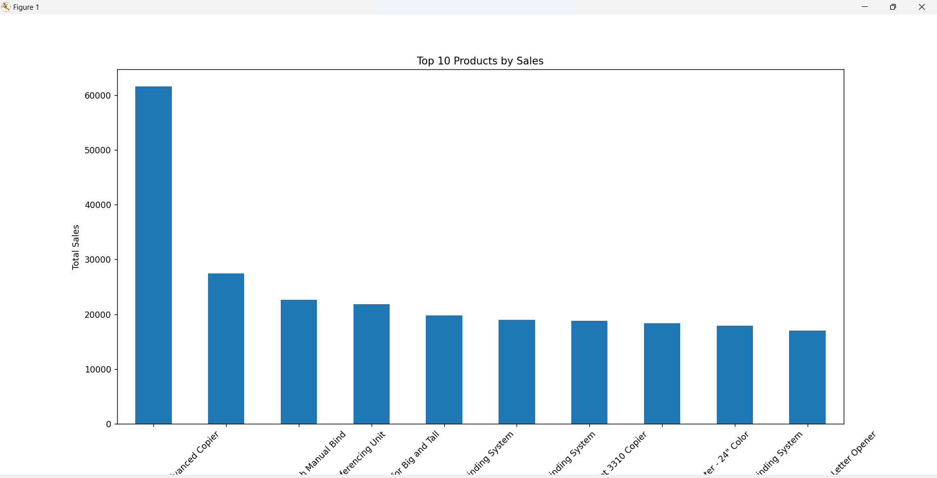

Slide 8
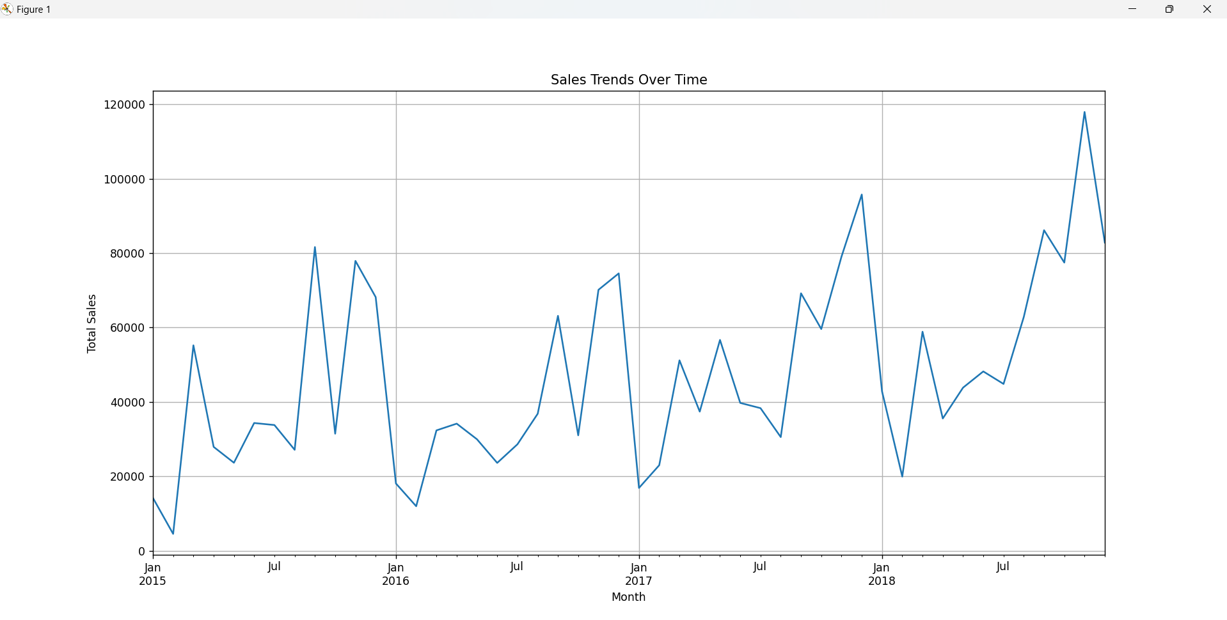
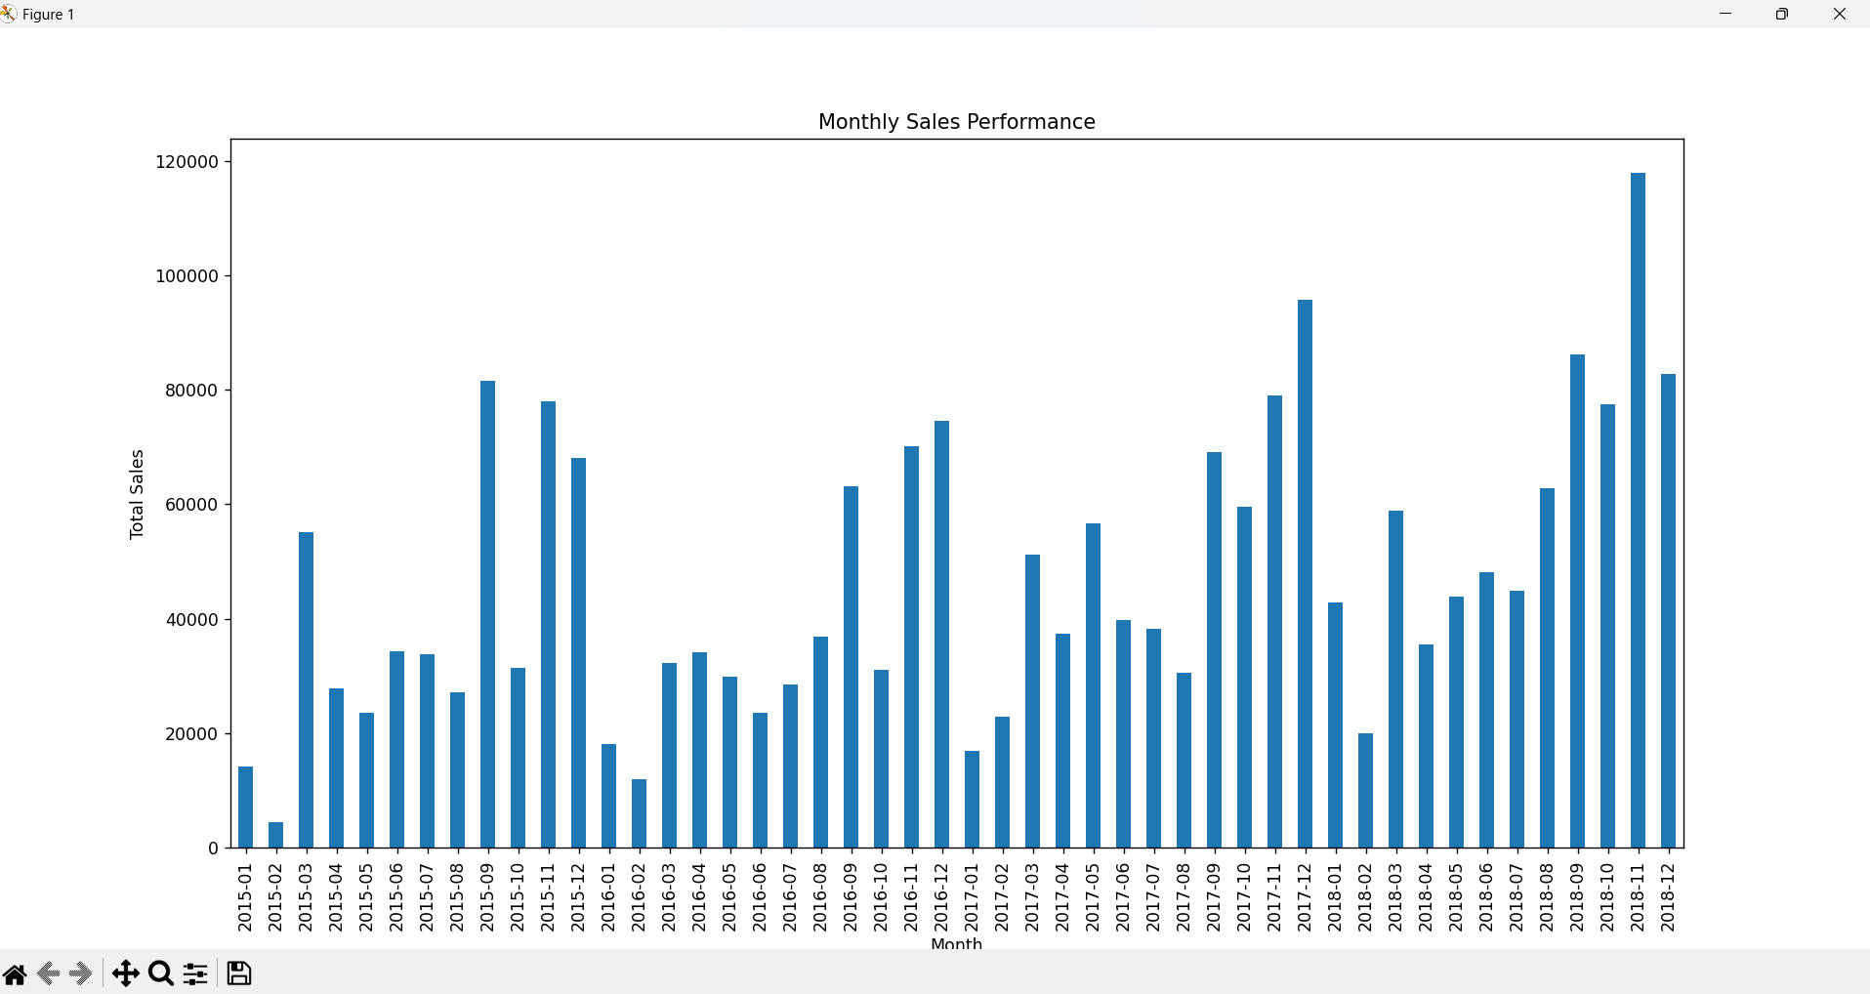

Slide 9
Task 2 :Weather Data Visualization
Vellingta P
13/01/2025

Slide 10
Description
The project processes a weather dataset to visualize temperature trends, identify patterns, and detect anomalies like extreme high or low temperatures.
Key insights are presented through line, scatter, and bar charts.
Tools and Technologies Used
Python
Libraries: Pandas, Matplotlib, Seaborn
Optional: Scikit-learn for predictive modeling
Visual Studio Code

Slide 11
Code Insights
Data Analysis
import pandas as pd
# Load the weather data
weather_data = pd.read_csv('weather_data.csv')
# Clean the data: Handle missing values
weather_data.dropna(inplace=True)
# Analyze temperature trends
temperature_trends = weather_data.groupby('Date')['Temperature'].mean()
Visualizations
import matplotlib.pyplot as plt
import seaborn as sns
# Line plot: Temperature trends over time
plt.figure(figsize=(10, 6))

Slide 12
temperature_trends.plot(kind='line')
plt.title('Temperature Trends Over Time')
plt.xlabel('Date')
plt.ylabel('Average Temperature (°C)')
plt.grid()
plt.show()
# Scatter plot: Temperature vs. Humidity
sns.scatterplot(x='Temperature', y='Humidity', data=weather_data)
plt.title('Temperature vs. Humidity')
plt.show()
Anamoly Detection
# Identify extreme temperatures
extreme_high = weather_data[weather_data['Temperature'] > weather_data['Temperature'].quantile(0.95)]
extreme_low = weather_data[weather_data['Temperature'] < weather_data['Temperature'].quantile(0.05)]

Slide 13
Results and Insights
Temperature shows seasonal variation , with peaks during summer months.
Detected extreme high temperatures during July and extreme low during January

Slide 14
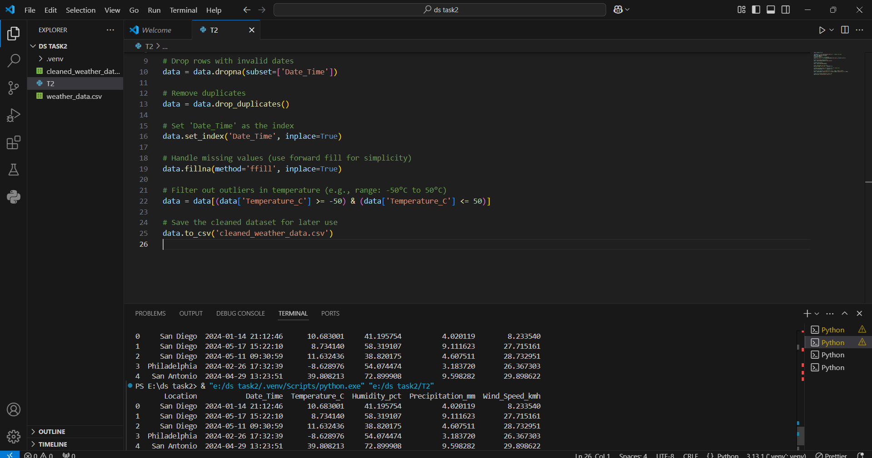
OUTPUT

Slide 15
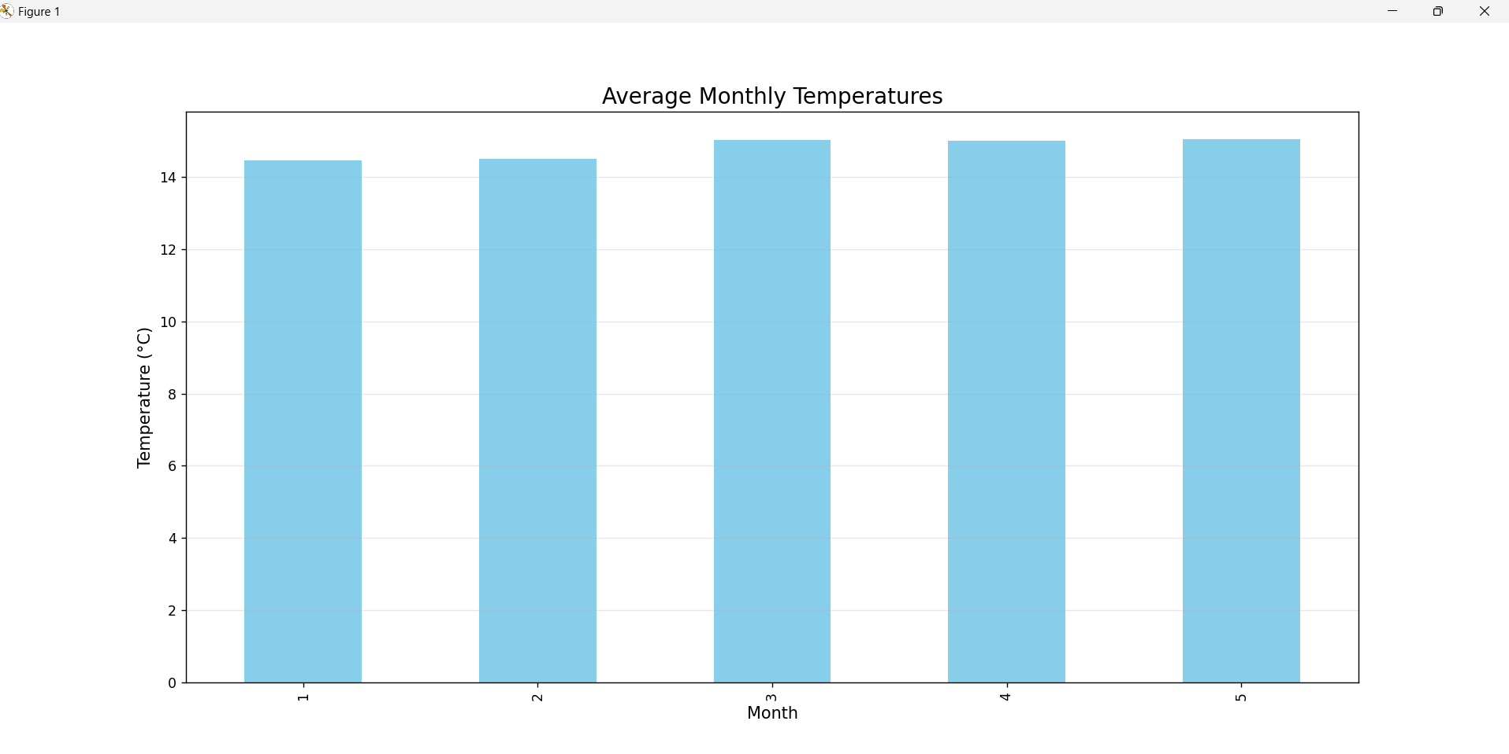

Slide 16
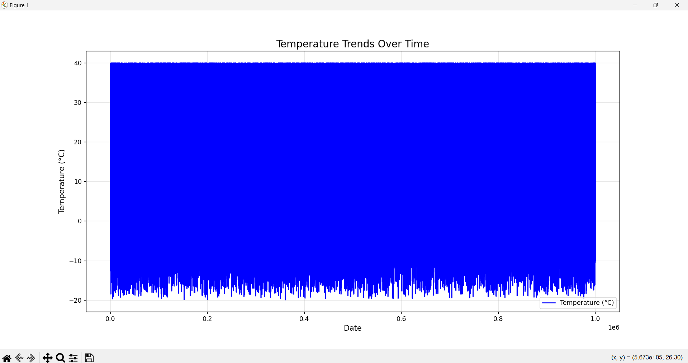
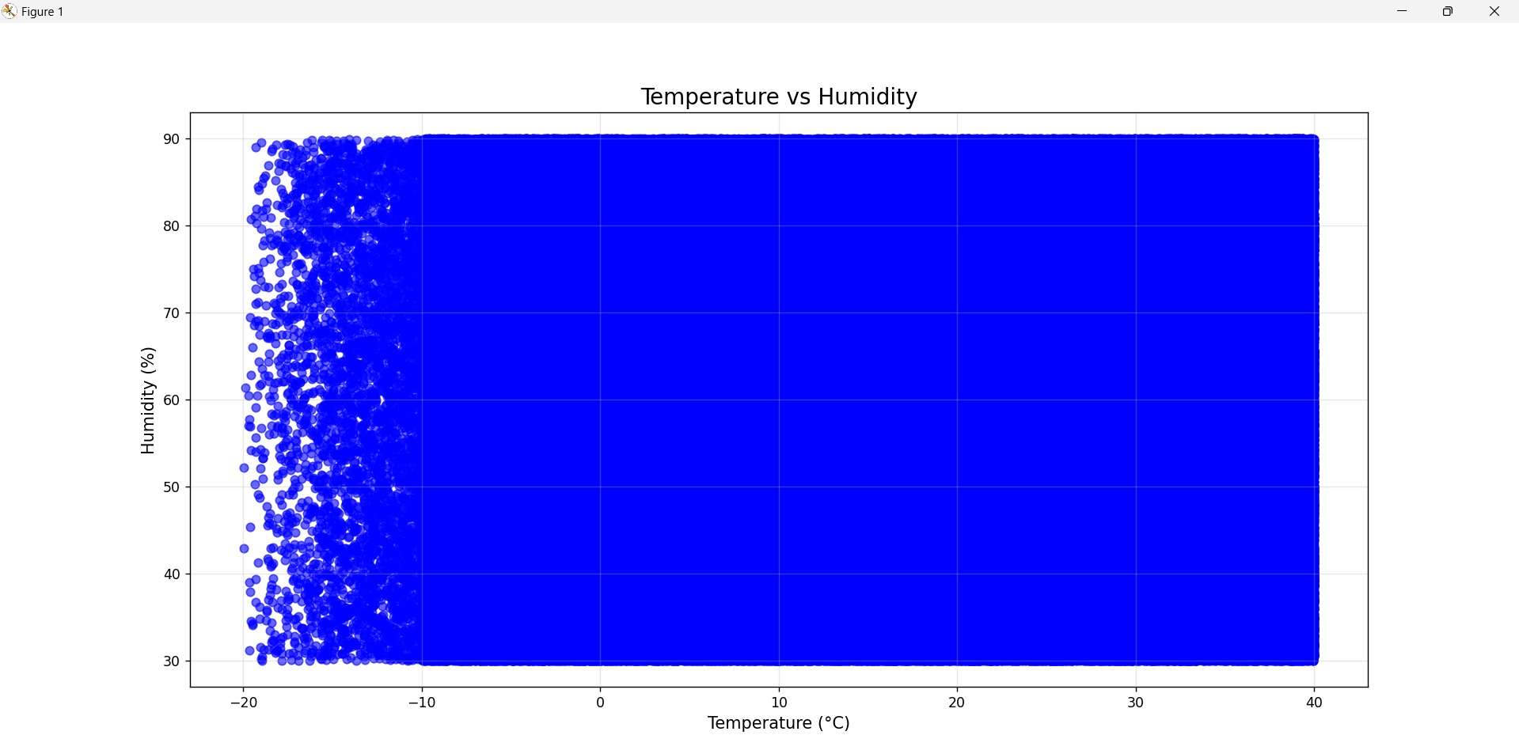

Slide 17
TASK 3 : Predicting House Prices
Vellingta P
21/01/2025

Slide 18
Description The project is about building a machine learning model to predict house prices using a dataset with house features such as size, location, age, etc. We have uses Linear Regression to train the model
Tools and Technologies Used
Python
Libraries: pandas, numpy, matplotlib, seaborn, scikit-learn, pickle
Visual Studio Code

Slide 19
Code Insights
from sklearn.linear_model import LinearRegression
# Initialize and train the model
model = LinearRegression()
model.fit(X_train, y_train)
from sklearn.metrics import mean_absolute_error, r2_score
# Make predictions
y_pred = model.predict(X_test)
# Evaluate the model
mae = mean_absolute_error(y_test, y_pred)
r2 = r2_score(y_test, y_pred)
print(f"Mean Absolute Error: {mae}")
print(f"R² Score: {r2}")

Slide 20
Results and Insights
The model’s performance was evaluated using the Mean Absolute Error (MAE) and R² (Coefficient of Determination) metrics:
MAE: 970043.40 (average absolute difference between predicted and actual prices)
R²: 0.65 (indicating that 65% of the variance in house prices was explained by the model)

Slide 21
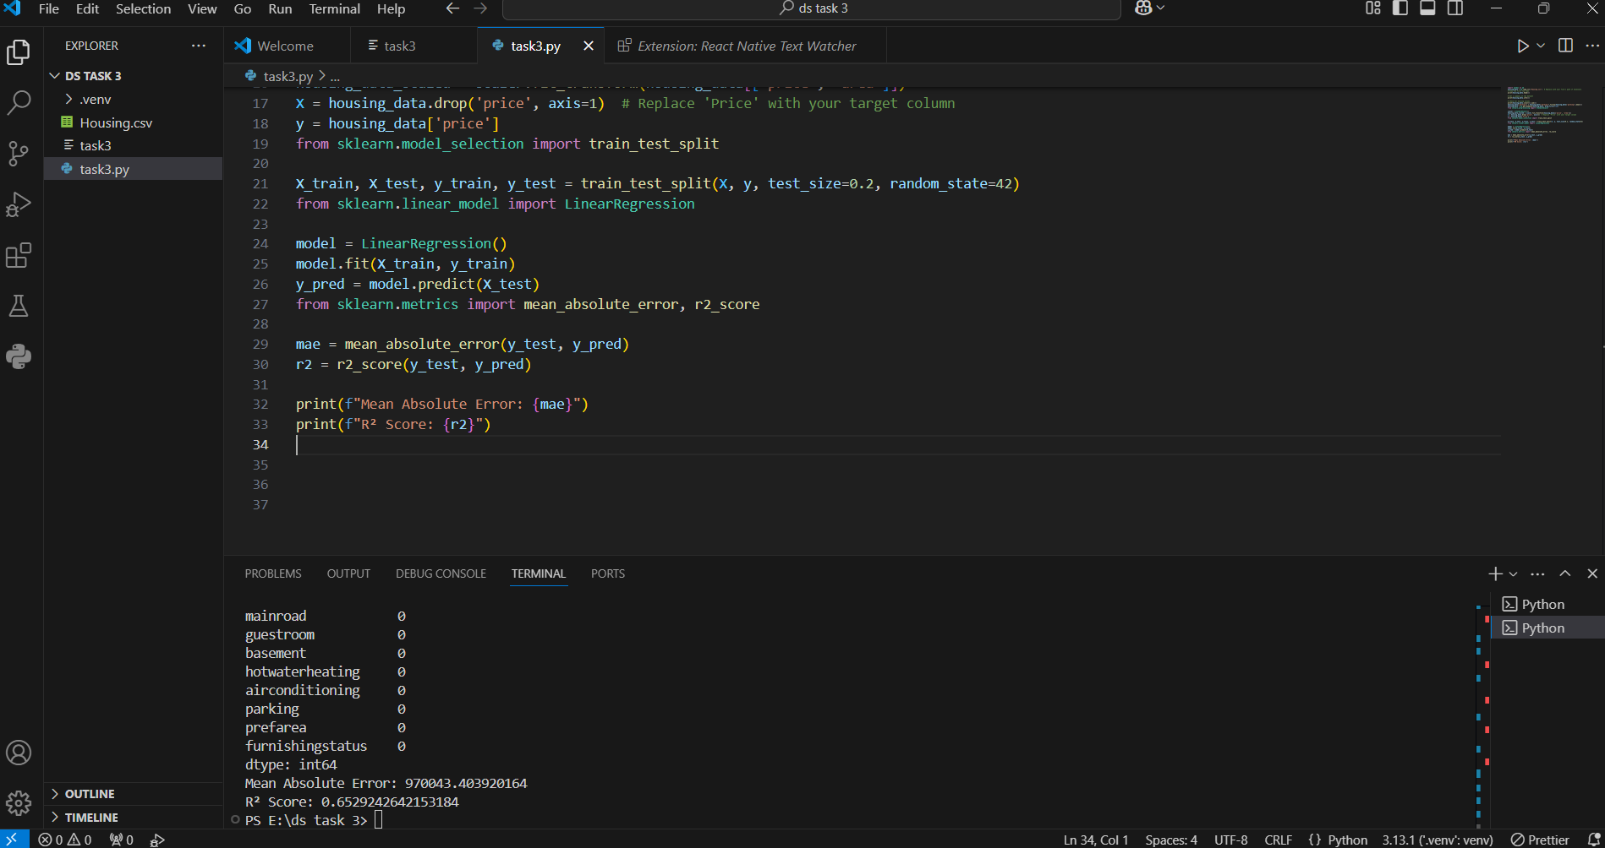
Output

Slide 22
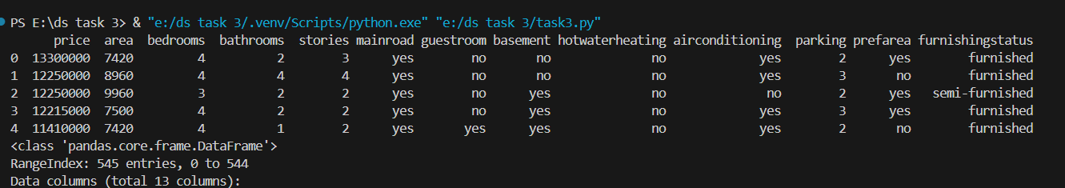
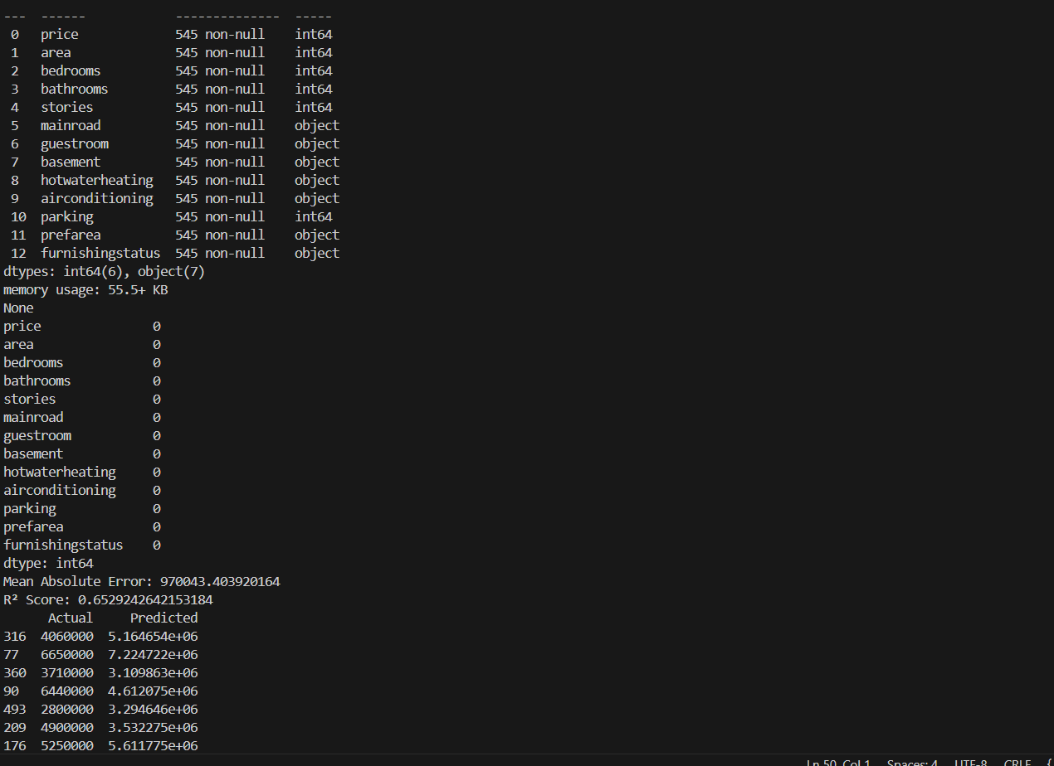

Slide 23
THANK YOU

